Slide 1
REVIEW 1: POST OPERATIVE LIFE EXPECTANCY PREDICTION AFTER THORACIC SURGERY USING MACHINE LEARNING
DONE BY:
KRUTHIKA MAHULIKAR(RA1611008010380)
AKSHAYA RAVICHANDRAN(RA1611008010008)
SHREYA AGARWAL(RA1611008010715)

Slide 2
INTRODUCTION:
Monitoring health outcomes is essential to enhance quality initiatives, healthcare management and consumer education.
The field of public health is constantly evolving in response to the needs of communities and populations around the world. Innovations in healthcare are in turn necessary in order to improve treatment, diagnosis, education, outreach, prevention of diseases.
AIM:
This project aims to predict the postoperative 1 year survival of lung cancer patients.

Slide 3
MOTIVATION:
If there is a pattern to be recognized with the attributes and whether the patients do not survive the one year mark, this would help physicians and patients make a more educated decision on whether they should proceed forward with surgery. If physicians feel that surgery will only hinder the patients quality of life with a recognized high risk of death within a one year time frame, then both parties can make a decision on whether to follow through surgery or alternative treatment methods.
Not only would this influence physicians and patients but this information could be utilised by health insurance companies when it comes to making decisions on finances for thoracic surgery.
Also clinical researchers could consolidate any useful findings to search for new research areas.
Thousands of people die every year due to lung cancer. We felt an urge to help out such lung cancer patients who suffer and in some cases even die after surgery as they consider it as the final resort. This project aims to help out such patients in making a more informed decision. This motivated us to take up this project.

Slide 4
LITERATURE REVIEW:
RESEARCH PAPERS:
Predictive Models for Post-Operative Life Expectancy after Thoracic Surgery
Nachev and T. Reapy Business Information Systems, Cairnes Business School,
National University of Ireland, Galway, Ireland
Abstract:
This is used using data mining techniques used in medical diagnosis particularly
for predicting chance of survival of patient after undergoing thoracic surgery.
Models discussed are decision trees, naïve Bayes and support vector machines.
Justification of why this research:
A major clinical decision problem in thoracic surgery in selecting patients for surgery,
taking into account possible risks and benefits for patients.

Slide 5
Factors considered:
long term, life expectancy, mortality prognosis in time horizon 1-5 years,
short term related to post-operative complications.
Results:
For the purposes of data pre-processing, model building and analysis we used tools
such as R Primary source for model estimation: confusion matrix
which resulted in true positives, true negatives, false positive,
false negative.
1. REFERENCE: A. Nachev and T. Reapy Business Information Systems, Cairnes
Business School, National University of Ireland, Galway, Ireland.

Slide 6
REQUIREMENT ANALYSIS:
FUNCTIONAL REQUIREMENTS:
DATASET INFORMATION:
The original dataset is from UCI Machine Learning Repository.
According to the main repository site, the data was collected retrospectively at Wroclaw Thoracic Surgery Centre for patients who underwent major lung resections for primary lung cancer in the years 2007-2011.
The report consists of 454 patient data.
The research database constitutes a part of the National Lung Cancer Registry, administered by the Institute of Tuberculosis and Pulmonary Diseases in Warsaw, Poland.
The following 17 attributes have been used for analysis:

Slide 7
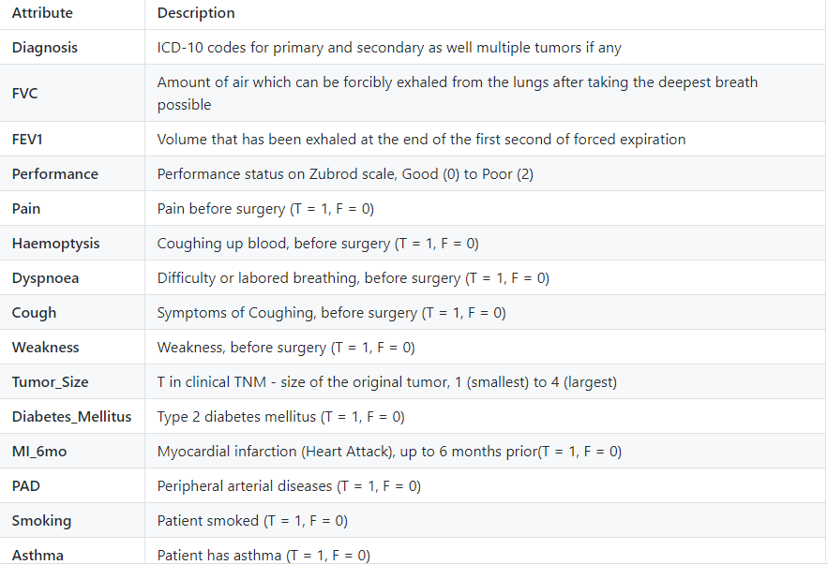
ATTRIBUTES:

Slide 8
MACHINE LEARNING ALGORITHMS WE AIM TO IMPLEMENT:
LOGISTIC REGRESSION:
It makes use of a bell-shaped S curve that is generated with the help of logit function to categorize the data into their respective classes.
SUPPORT VECTOR MACHINE:
SVMs are powerful classifiers that are used for classifying the binary dataset into two classes with the help of hyperplanes.
RANDOM FOREST CLASSIFIER:
Random Forests are an ensemble learning method that is for performing classification, regression as well as other tasks through the construction of decision trees and providing the output as a class which is the mode or mean of the underlying individual trees.

Slide 9
Kth NEAREST NEIGHBOUR:
In pattern recognition, the k-nearest neighbors algorithm (k-NN) is a non-parametric method used for classification and regression.
DECISION TREE:
A decision tree is a flowchart-like structure in which each internal node represents a "test" on an attribute (e.g. whether a coin flip comes up heads or tails), each branch represents the outcome of the test, and each leaf node represents a class label (decision taken after computing all attributes).
NAÏVE BAYES:
Naive Bayes classifiers are a collection of classification algorithms based on Bayes' Theorem. It is not a single algorithm but a family of algorithms where all of them share a common principle, i.e. every pair of features being classified is independent of each other.
DEEP LEARNING:
DEEP NEURAL NETWORKS:
A deep neural network (DNN) is an artificial neural network (ANN) with multiple layers between the input and output layers.

Slide 10
NON FUNCTIONAL REQUIRMENTS:
We aim to compare the accuracy achieved by employing all the above stated machine learning algorithms and find out the most accurate one suitable for prediction of life expectancy.
Later, we aim to achieve a higher accuracy compared to the machine learning techniques by employing deep neural networks technique.
We ideally expect to achieve an accuracy of not less than 89%.

Slide 11
SOFTWARE REQUIREMENTS:
Panda
Jupyter Notebook
Pytorch
Matplotlib

Slide 12
HARDWARE REQUIREMENTS:
1gb ram
2gb storage
1280*720 screen resolution
Intel atom 1.2ghz processor

Slide 13
PROPOSED METHODOLOGY:
MODULES:
MODULE 1: DATA CLEANSING FOR EXPLORATION
The data will need to be explored to find any missing values and if there
is a need to tidy up the data for exploration.
MODULE 2: EXPLORATORY DATA ANALYSIS
EDA will consist of exploring all attributes’ values in terms of what
they represent, how they relate to each other and the quantitative aggregate values.
MODULE 3: DATA VISUALISATION
Once data is ready, visualization in graphs will help quickly assess data patterns
and overall trends.

Slide 14
MODULE 4: HYPOTHESIS TESTING
Hypothesis testing with the null being the attributes having no relations to death rate will be performed.
MODULE 5: DETERMINING ACCURACY OF MODEL USING ML ALGORITHMS
Supervised ML will take into consideration the attributes of concern,
which either were determined by EDA or will be determined tuning the ML model,
to determine accuracy of the 1-year death rate.

Slide 15
IMPACT OF THE SOLUTION:
This project will greatly help thousands of lung cancer patients around the world to make an informed decision i.e: whether to proceed with surgery or not by predicting their life expectancy one year post the surgery.
If physicians feel that surgery will only hinder the patients quality of life with a recognized high risk of death within a one year time frame, then both parties can make a decision on whether to follow through surgery or alternative treatment methods.
Not only would this influence physicians and patients but this information could be utilised by health insurance companies when it comes to making decisions on finances for thoracic surgery.
Also clinical researchers could consolidate any useful findings to search for new research areas.

Slide 16
HOW THIS PROJECT HELPS SOCIETY:
This project will greatly help thousands of lung cancer patients around the world to make an informed decision i.e: whether to proceed with surgery or not by predicting their life expectancy one year post the surgery.

